Slide 1

Employee Attendance Management System
A comprehensive SQL implementation for tracking employee attendance, check-in/check-out times, and generating detailed reports

Slide 2
Introduction
In any organization, employee attendance plays a crucial role in productivity and performance evaluation.
Traditional attendance systems like registers are inefficient and prone to errors.
A digital attendance system helps in storing, managing, and analyzing employee data efficiently.
This project demonstrates how SQL can be used to build an attendance management system.

Slide 3
Problem Statement
Manual attendance systems have several limitations:
Time-consuming process
Difficult to maintain records
High chances of human error
Hard to generate reports
There is a need for a structured system to store and analyze attendance data effectively.

Slide 4
Objectives
To design a structured database for employee attendance
To store employee and department details
To track daily attendance records
To identify late check-ins and absentees
To generate reports for decision-making

Slide 5
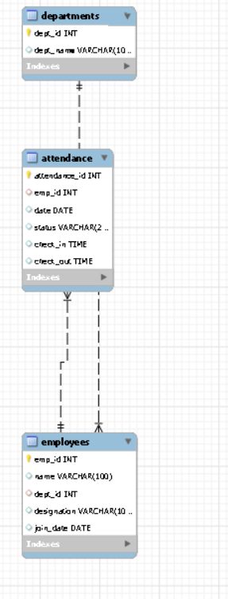
ER Diagram
Employees (1) ---- (M) Attendance
emp_id is Primary Key
emp_id in attendance is Foreign Key

Slide 6
Tools & Technologies
MySQL – Used for database management
SQL (Structured Query Language) – Used for writing queries
Concepts used:
DDL (Data Definition Language)
DML (Data Manipulation Language)
Joins
Aggregate Functions

Slide 7
Database Overview
Database Name: employee_project
The database contains 3 main tables:
Departments
Employees
Attendance
These tables are connected using relationships (foreign keys)

Slide 8

Database Creation
CREATE DATABASE creates a new database
USE selects the database for operations
✅ Output:
Database employee_project created successfully
Database employee_project selected (in use)

Slide 9
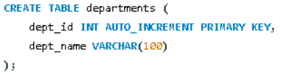

Departments Table
The departments table is used to store information about different departments in the organization.
It acts as a master table that helps in organizing employees based on their departments.

Slide 10
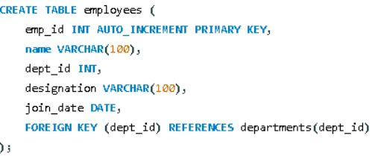

Employees Table
Stores employee details
dept_id links to departments table
Ensures relational integrity

Slide 11
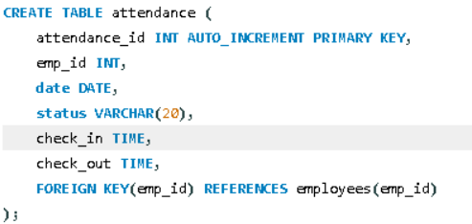

Attendance Table
Stores daily attendance
Status can be Present / Absent / Leave
Tracks check-in and check-out time

Slide 12
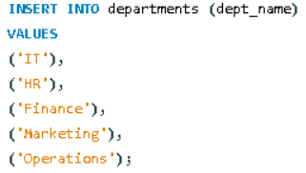
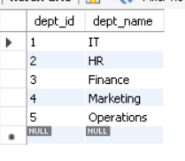
Data Insertion (Departments)
Adds department records
Multiple values inserted in one query

Slide 13
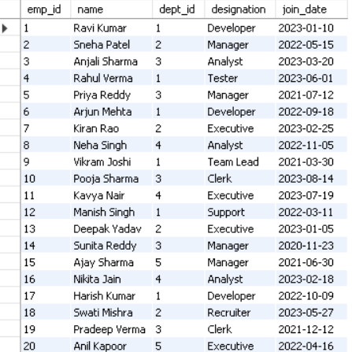
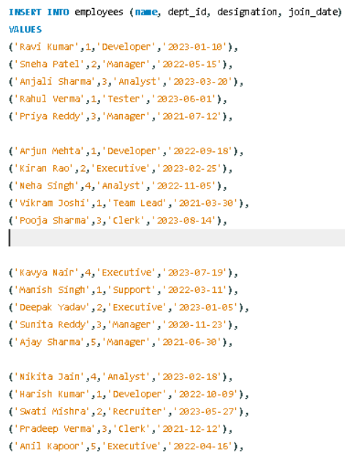
Data Insertion (Employees)
Inserts employee details
Links employee to department

Slide 14
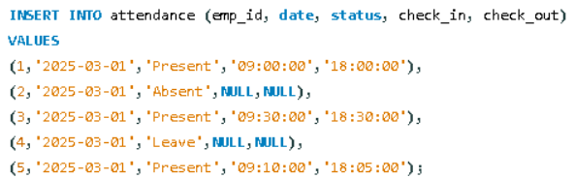
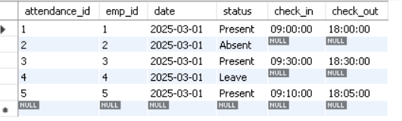
Data Insertion (Attendance)
Stores daily attendance
NULL used when absent

Slide 15
Viewing Data
SELECT * FROM employees;
Used to display all records
Helps verify inserted data
SELECT * FROM attendance;

Slide 16
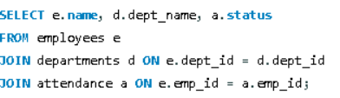
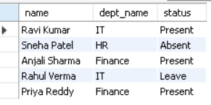
Employee + Department + Status (JOIN)
Combines 3 tables using JOIN
Displays:
Employee Name
Department Name
Attendance Status

Slide 17
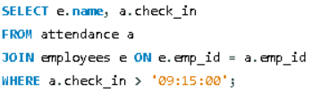

Late Coming Employees
Finds employees who checked in after 9:15 AM
Displays:
Employee Name
Check-in Time

Slide 18


Employee Count per Department
Counts number of employees in each department
Groups data by department

Slide 19


Find employees with the latest joining date

Slide 20


Find employees with the earliest joining date

Slide 21
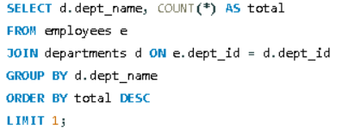

Find department with maximum employees

Slide 22
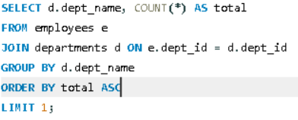

Find department with minimum employees

Slide 23
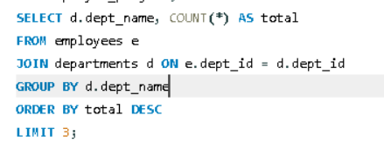
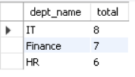
Find Top 3 Departments by Employee Count

Slide 24
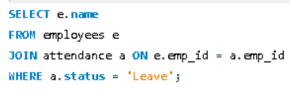

Find Employees Who Took Leave
attendance_management.sql

